Slide 1
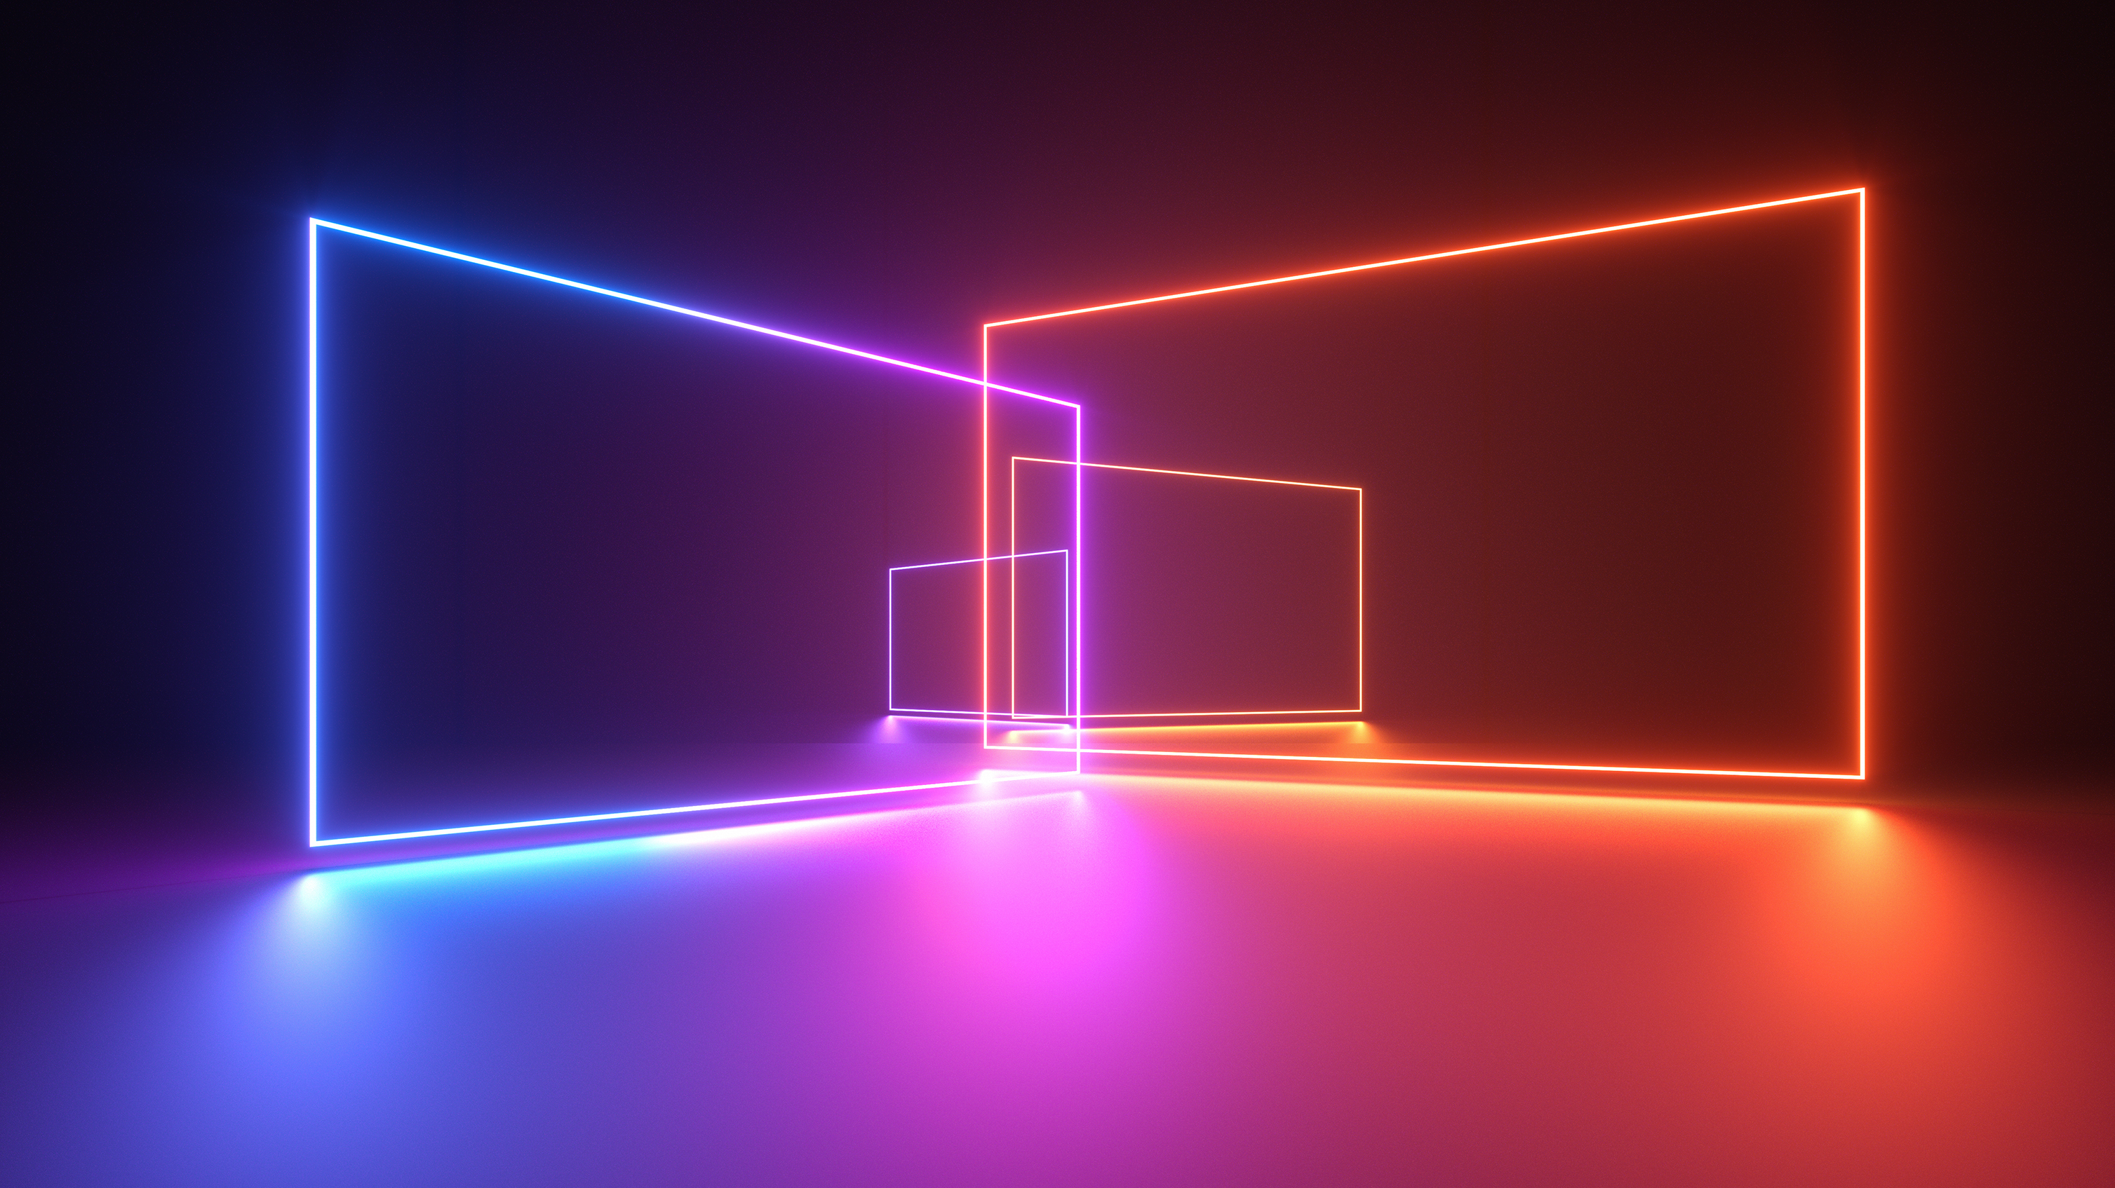
Team Members:
Welcome To
Ashish Thakur (21NA30004)
Team-18
Bhavesh Mukheja (21PH10008)
Final Week
Mannan Thakur (21MT10030)
Presentation
Sayan Mandal (21MT10049)
Vibrant LED Cube

Slide 2
HIGHLIGHTS of WORK DONE
Week 1: Purchasing of different products from online and offline and trying to figure out the code for the led.
Week 2: Creation of schematic of prototype circuit along with working on the various possible effects that could be coded for the cube.
Week 3: Completion of structure midway through along with completion of all coding effects and circuit schematics.
Week 4: Completion of the final hardware plus its testing. Filming of video also completed.

Slide 3
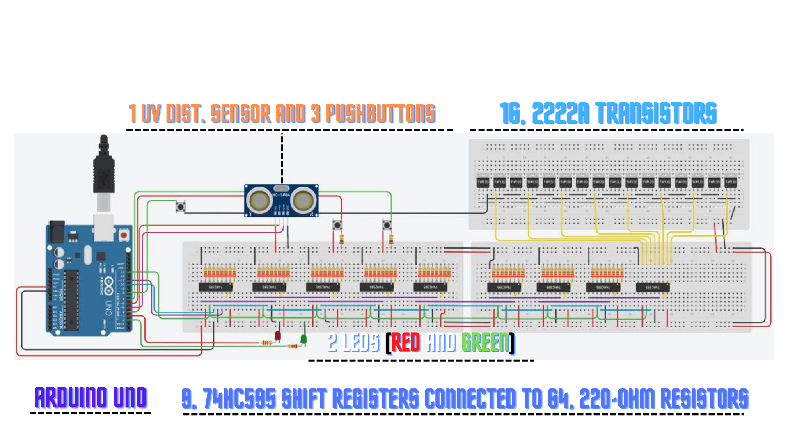
CIRCUIT DIAGRAM

Slide 4

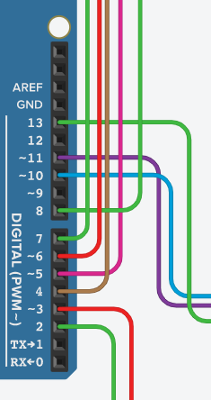
Arrangements of the components
Digital Pin-2 -> Green LED
Digital Pin-7 -> Green Pushbutton
Digital Pin-3 -> Red LED
Digital Pin-8 -> Emitter Pushbutton
Digital Pin-4 -> Trigger Pin of UV Sensor
Digital Pin-10 -> RCLK Pin
Digital Pin-5 -> Echo Pin of UV Sensor
Digital Pin-11 -> SER Pin
Digital Pin-6 -> Red Pushbutton
Digital Pin-13 -> SRCLK Pin

Slide 5
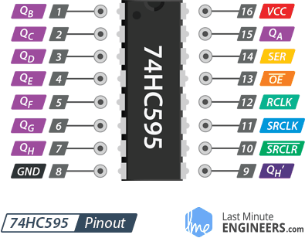
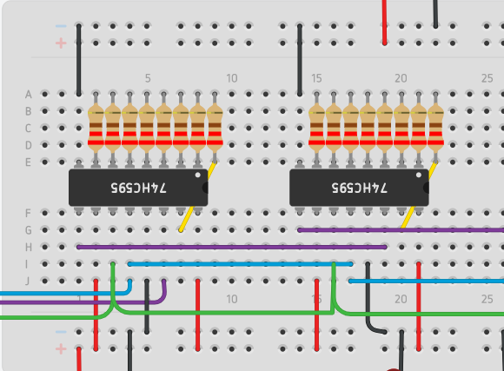
Basic functioning of the circuit
74HC595 Shift Registers are the most important components of this project.
The 74HC595 Shift Register takes in input signals through 3 pins which are RCLK Pin, SER Pin, SRCLK Pin that are connected to the Arduino UNO as mentioned in the previous slide
A Shift Register is connected to other in the way shown beside.
64 220-ohm resistors are connected to the 8 Shift Registers that will be connected to the LED Cube.
The 9th Shift Register's 8 output pins are connected to the combination of 16 2222A Transistors.
The 8x8x8 LED Cube will be connected through the end terminals of the resistors and transistors.
Once all the connections are made, we can control 512 Blue LEDS using code.

Slide 6
CODE For The Project

Slide 7

Our code consists of the following FOUR Effects :
Rain: An effect given to the cube such that it looks like a soothing rain.
Plane Boing: The moving of a plane across the cube.
Woop-Woop: Expanding of a small cube from inside out.
Text: As the name suggests, it is an effect which shows text using LEDS

Slide 8



Remarks
The actual circuit is made using Prototype Board
So, the circuit is economically feasible and compact
The Software used in this project are: TINKERCAD and Arduino IDE

Slide 9

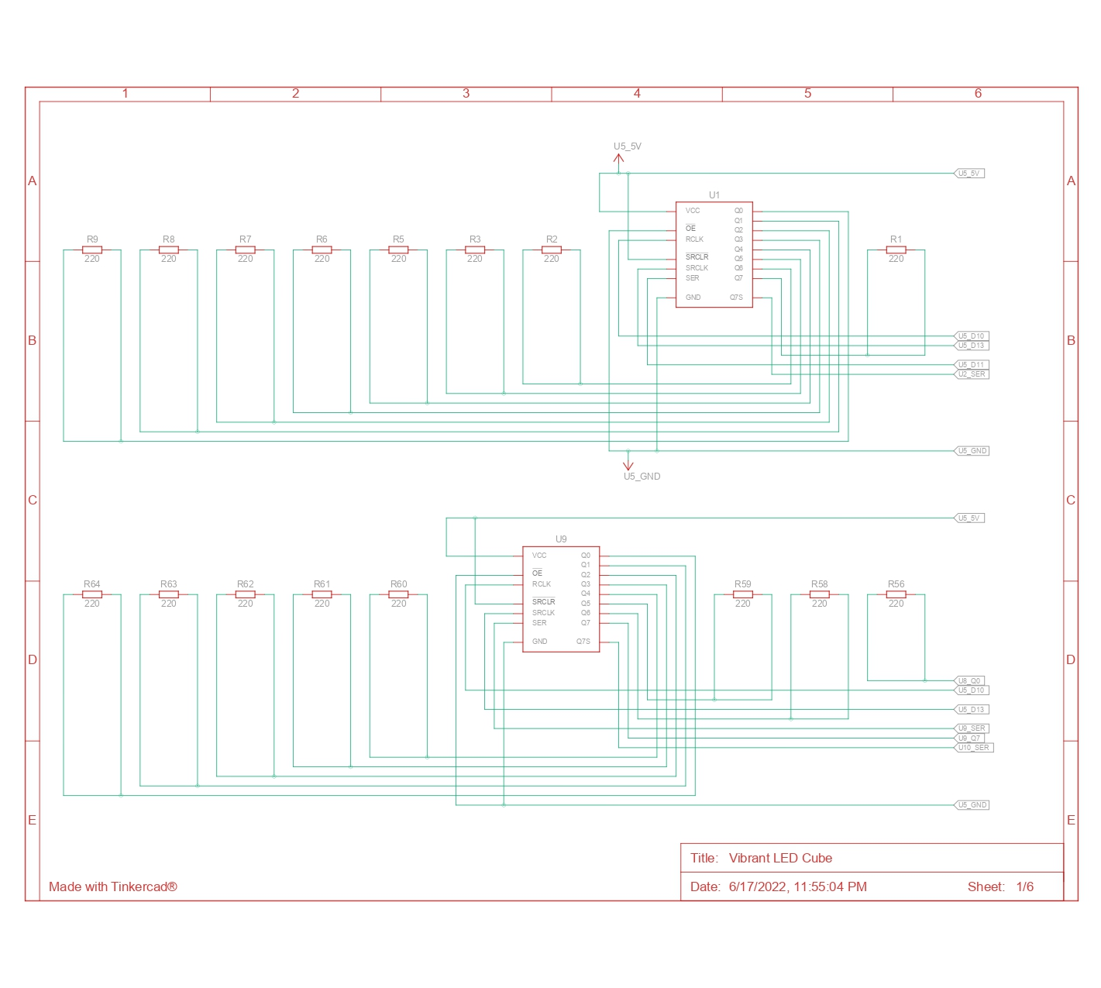
Circuit schematics

Slide 10
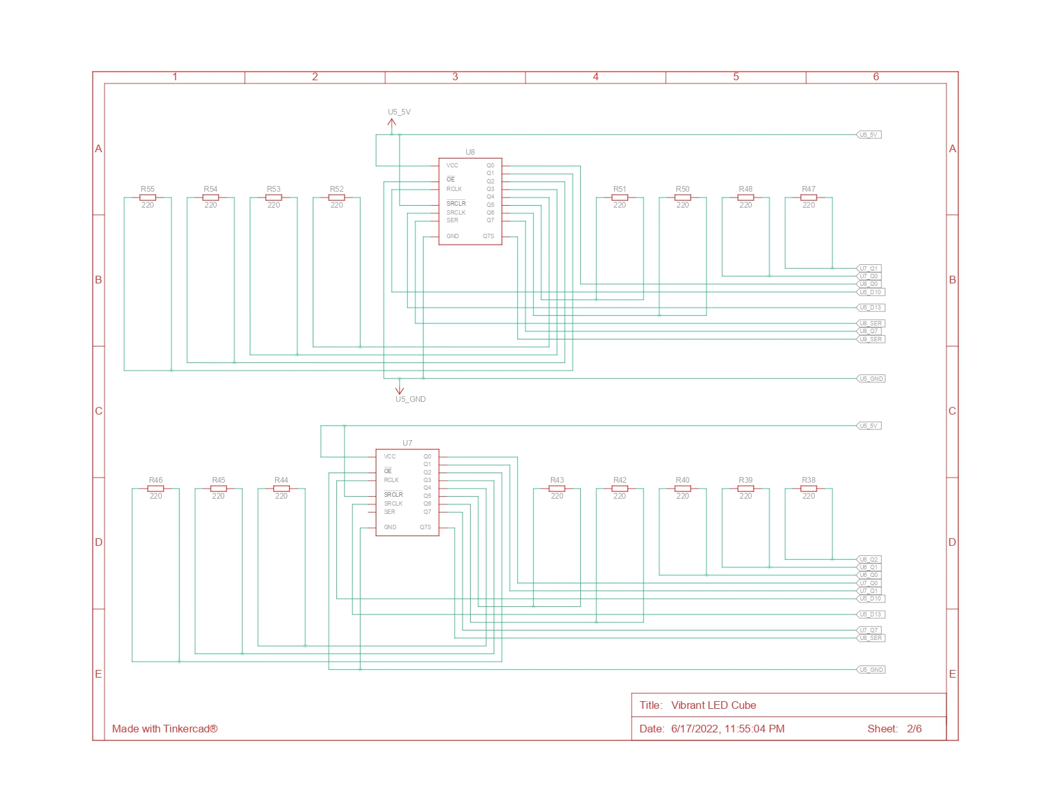

Slide 11
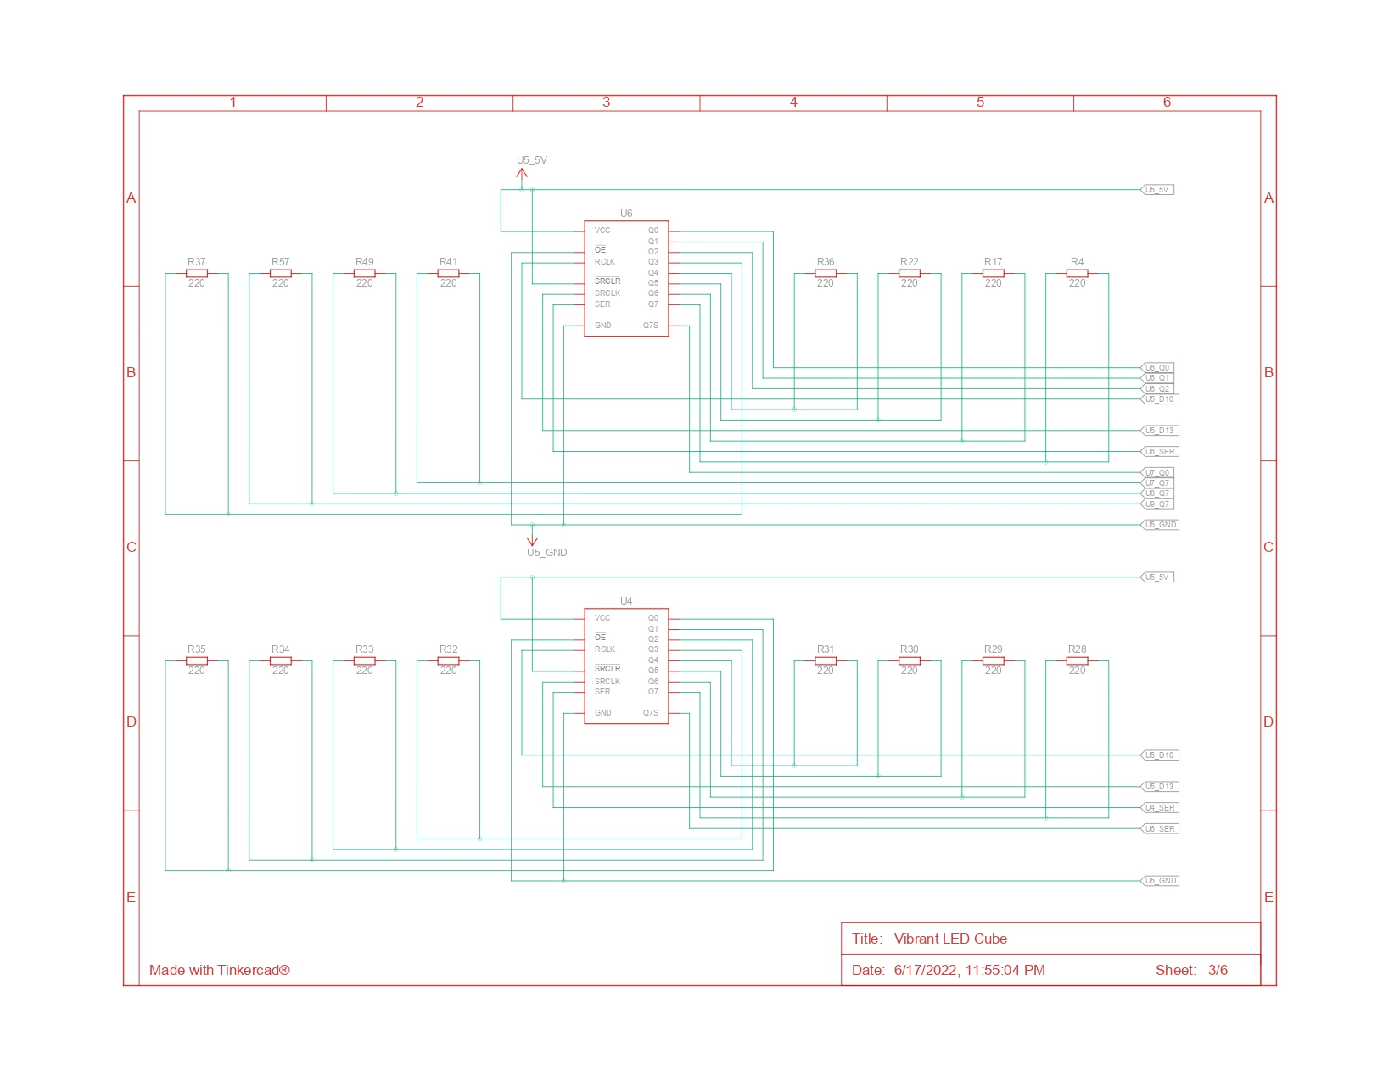

Slide 12
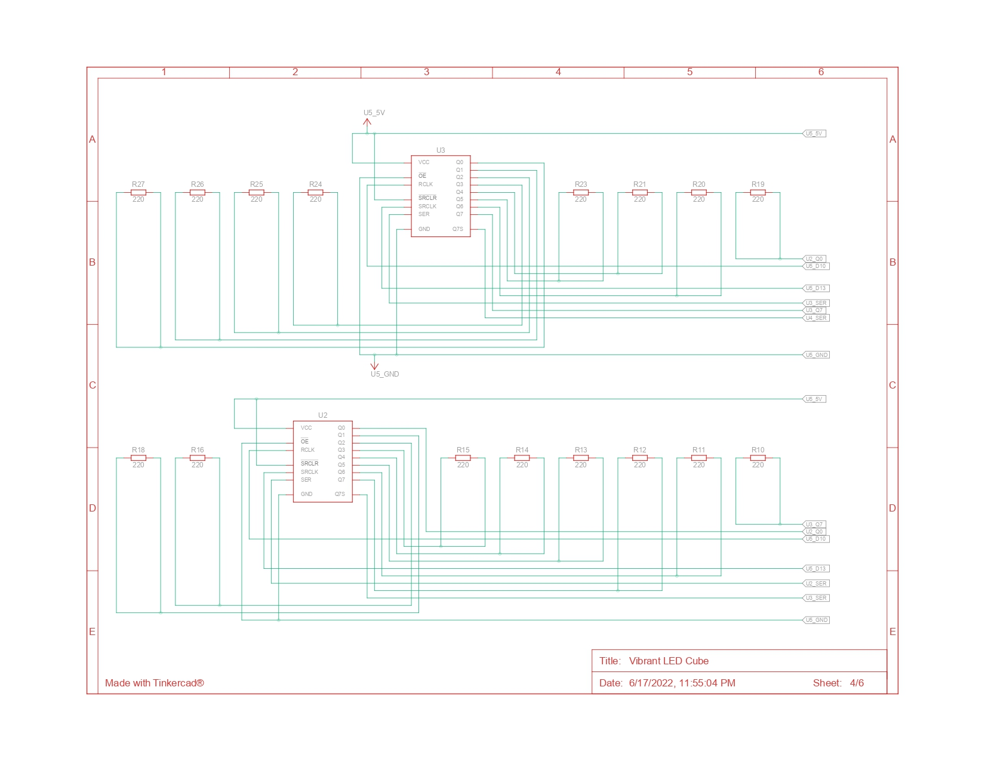

Slide 13
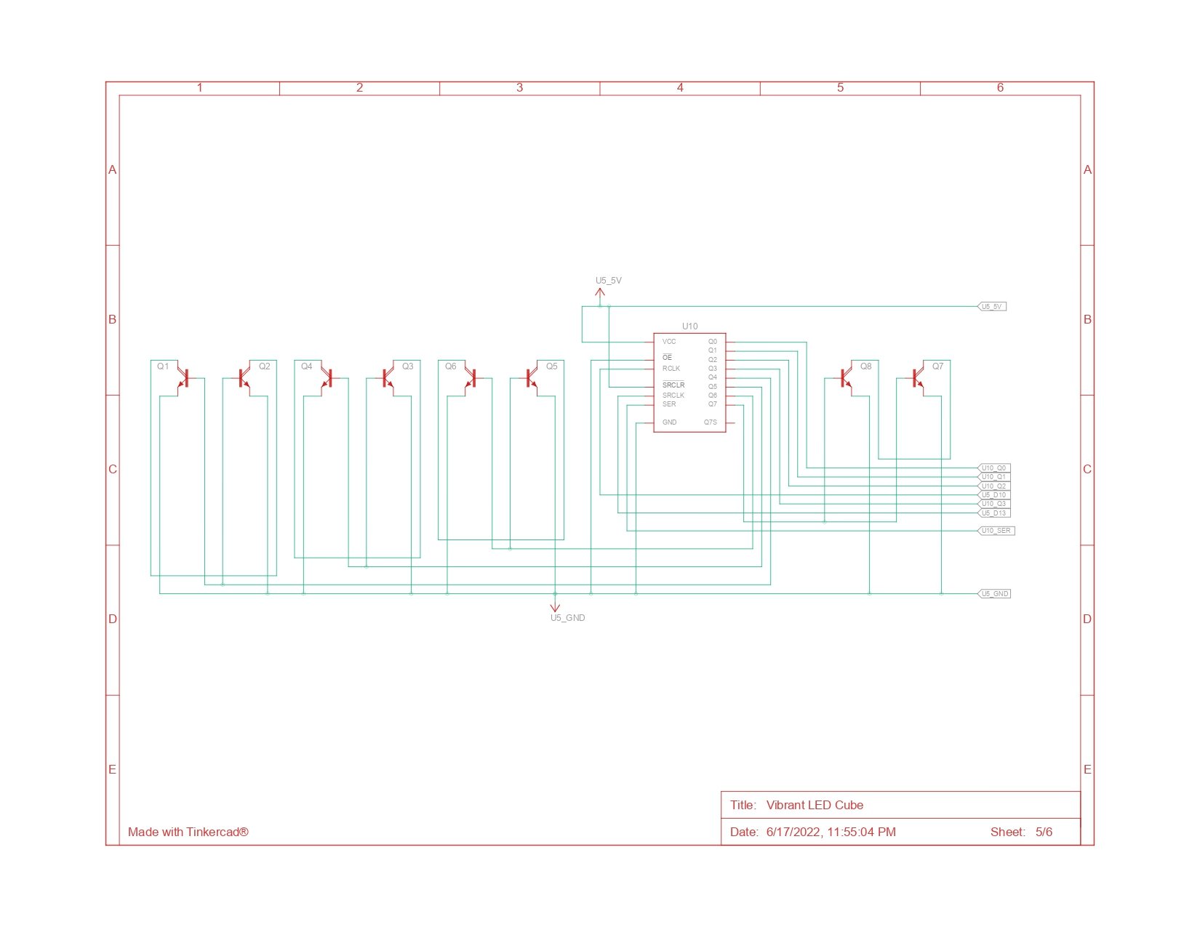

Slide 14
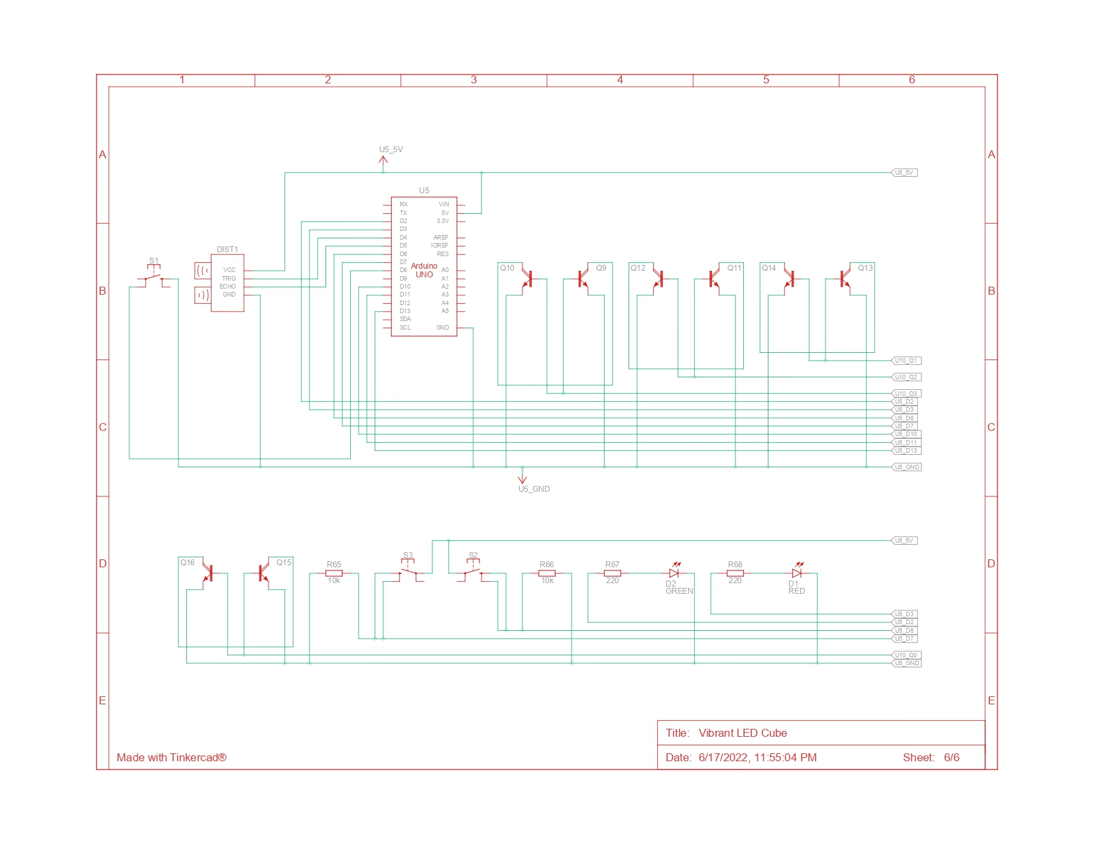

Slide 15



Since the Actual Circuit is quite complex.
Let's understand the Basic Functioning of the Circuit through a Demo Circuit.

Slide 16
DEMO CIRCUIT

Slide 17
PRACTICAL Applications of the Project
The LED cube can be used for decorative purposes. Its aesthetic beauty is pleasing to the eye.
The LED cube can be used in parties and functions. The UV distance sensor enables in giving different effects at different distances, so it can be used as a party game.
Furthermore, with advanced resources it can also be used as a display.

Slide 18

What was left out
We were unable to code for the LED in such a way that on the beats of a song, some particular effects could be produced. Despite several efforts, we were unable to do so. One of the problems faced was the fact that there was being difficultly in creating distinction between the respective beats and hence it was being tough to correspond a particular beat to a particular effect.

Slide 19
Work done by each member
Bhavesh Mukheja: Making of PPT for all the weeks
Making of the TINKERCAD schematics and circuit
Integrating the UV distance sensor code with the effects code
Ashish Thakur: Assembling of the hardware components
Complete testing and running of the LED cube
Video Editing
Mannan Thakur: Writing the code for the effects and UV distance sensor for the LED cube
Making of PPT for week 4
Sayan Mandal: Writing the code for the effects and UV distance sensor for the LED cube
Making of PPT for week 1

Slide 20


